Slide 1



SRM INSTITUTE OF SCIENCE AND TECHNOLOGY
KATTANKULATHUR- 603203
DIRECTORATE OF ONLINE EDUCATION
BASIC AND SCIENTIFIC MODERN CALCULATOR
INTERNSHIP REPORT VIVA
NAME OF STUDENT: YUGENDRAN S
SUBJECT CODE: V20PCA305
ENROLMENT NUMBER: EA2332251010092
PROJECT GUIDE: DR.G.BABU

Slide 2
CONTENTS
c
System Requirements
Module Description
Output Screenshot
Feature Enhancement
Conclusion
References
Abstract
Introduction
Feature
Existing system
Proposed system
Data flow Diagram

Slide 3
ABSTRACT
This project focuses on the development of a Scientific Calculator Web Application, providing users with a versatile tool for performing both basic and advanced mathematical operations. The application is designed with a user-friendly interface and incorporates features that enhance usability and responsiveness across devices. It toggles seamlessly between a basic mode with four-column layouts and a scientific mode that displays advanced functions like trigonometric and logarithmic calculations. The implementation leverages HTML, CSS, and JavaScript to create a highly interactive and responsive user interface without any backend dependencies. The scientific mode introduces additional functionalities organized in a user-friendly layout that adapts dynamically to the selected mode. The calculator is lightweight, fully client-side, and can operate effectively across various devices and browsers.

Slide 4

INTRODUCTION
In today's digital age, the need for efficient and reliable computational tools has grown significantly in the modern digital era. A scientific calculator is an essential resource for students, professionals, and researchers, aiding in solving complex mathematical problems quickly and accurately. This project aims to develop a Scientific Calculator Web Application, which offers the functionality of both basic and advanced calculators within a seamless and intuitive interface.
The application is designed with simplicity and versatility in mind, enabling users to toggle effortlessly between basic and scientific modes. In basic mode, users can perform standard arithmetic operations such as addition, subtraction, multiplication, and division. Switching to scientific mode introduces features like trigonometric functions, logarithms, and exponential calculations, catering to more complex computational needs.

Slide 5

FEATURES
Toggle Between Basic and Scientific Modes
The calculator provides two modes: Basic and Scientific. Users can switch easily, with basic mode offering arithmetic operations and scientific mode enabling advanced functions like trigonometry and logarithms. Scientific features are displayed in a separate row for clarity and accessibility.
Dynamic and Responsive Design
The calculator ensures a consistent user experience across devices. Button sizes remain uniform, and the display screen automatically adjusts text size to fit content. The layout adapts dynamically to both basic and scientific modes, enhancing usability.
Theme Customization with Light and Dark Modes
The application offers a toggle for light and dark themes, improving usability in various lighting conditions. The interface updates instantly to match user preferences, providing a visually appealing and personalized experience.

Slide 6
PRODUCT SCOPE
The Scientific Calculator Web Application is a lightweight, client-side tool designed to deliver accurate mathematical computations through a user-friendly interface. The product is developed with a focus on simplicity, responsiveness, and extensibility, targeting a diverse audience that includes students, educators, professionals, and researchers.
The primary goal of the project is to create a flexible web-based calculator capable of handling both basic arithmetic and advanced scientific calculations. The application aims to meet the diverse needs of users, from simple daily math tasks to complex problem-solving requirements.

Slide 7
SYSTEM REQUIREMENTS
HARDWARE CONFIGURATIONS
Processor : I3/Intel Processor
RAM : 2GB (min)
Hard Disk : 32 GB
Key Board : Standard Windows Keyboard
Mouse : Two or Three Button Mouse
Monitor : Any
SOFTWARE CONFIGURATIONS
Operating System : Cross-Platform Compatibility
Server side Script : HTML, CSS, Bootstrap & JS
Programming Language : JavaScript
IDE/Workbench : VS Code
Technology : Modern JavaScript (ES6+)
Server Deployment : Static Hosting (e.g., GitHub Pages, Netlify)

Slide 8

EXISTING SYSTEM
PROPOSED SYSTEM
The proposed system is a responsive, web-based calculator application that combines both basic and scientific functionalities in a single interface. Users can switch seamlessly between basic and scientific calculator modes with a single click. The scientific features are neatly displayed at the top of the interface, ensuring easy access. This system is designed using modern web technologies such as HTML, CSS, JavaScript, and Bootstrap, ensuring a user-friendly and visually appealing interface
The existing system for performing calculations primarily relies on basic calculators or traditional manual methods for simple arithmetic operations. For scientific calculations, users typically depend on standalone scientific calculators, which can be costly and cumbersome. Existing web-based calculators often lack flexibility in switching between basic and scientific modes seamlessly. Furthermore, most applications do not have a responsive user interface, making it difficult to use on various devices. The lack of customization options and modern design further limits user engagement.

Slide 9
MODULES
Basic Calculator Module:
Description: This module is responsible for creating a visually appealing and intuitive user interface for the calculator. It ensures a seamless user experience, enabling users to switch between basic and scientific modes easily.
Features:
Displays buttons for numeric inputs, operations, and scientific functions.
Dynamic layout adjustment for 4-column (basic) and 5-column (scientific) modes.
Responsive design for compatibility with devices of varying screen sizes.

Slide 10
MODULES
Scientific Calculator Module:
Description: This module adds advanced mathematical functionality, allowing users to perform complex scientific calculations.
Features:
Includes functions like trigonometric calculations (sin, cos, tan), square root, logarithms, and exponents.
Buttons are dynamically displayed when the scientific mode is activated.
Organized layout for easy access to scientific features.

Slide 11
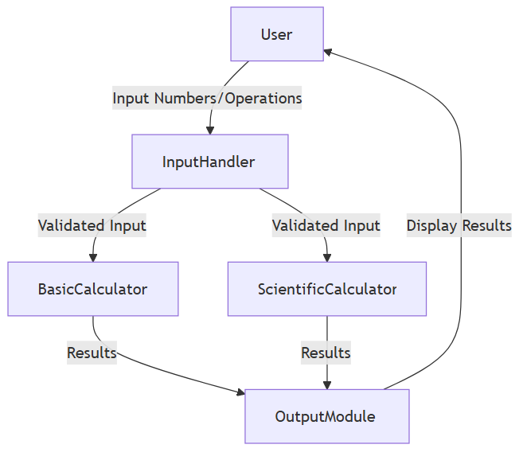
DATA FLOW DIAGRAM (DFD)
High Level DFD – Context Diagram

Slide 12
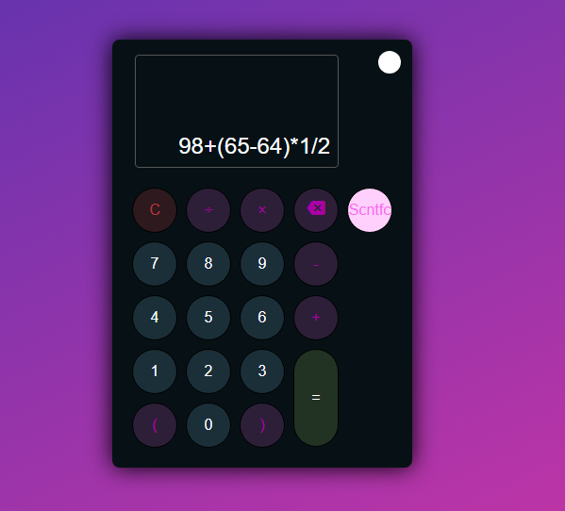
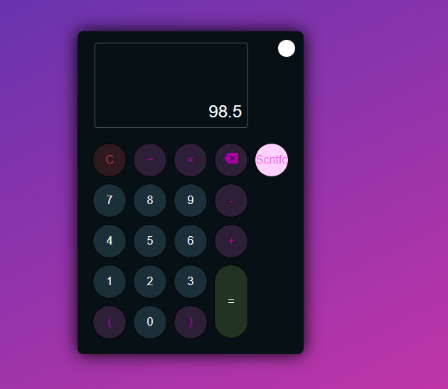
OUTPUT SCREENSHOT

Slide 13
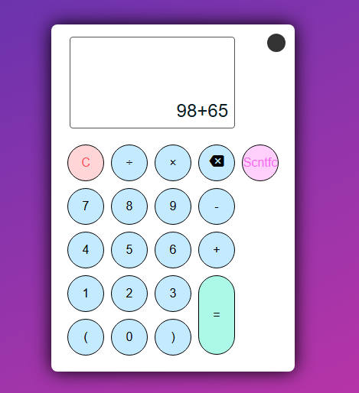
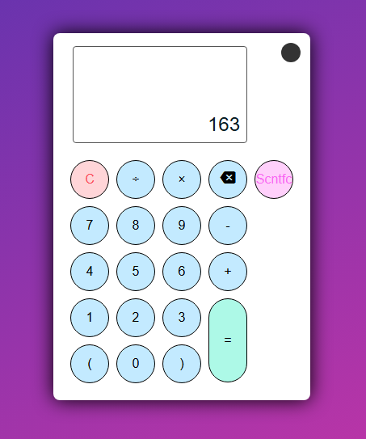
OUTPUT SCREENSHOT

Slide 14
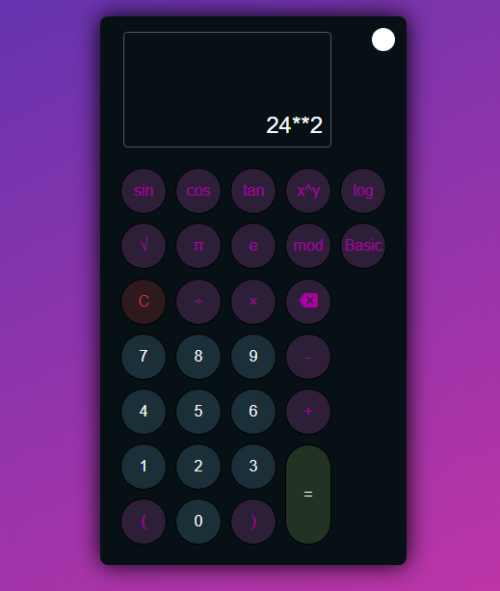
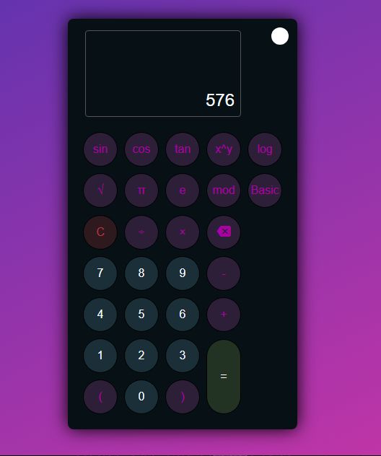
OUTPUT SCREENSHOT

Slide 15
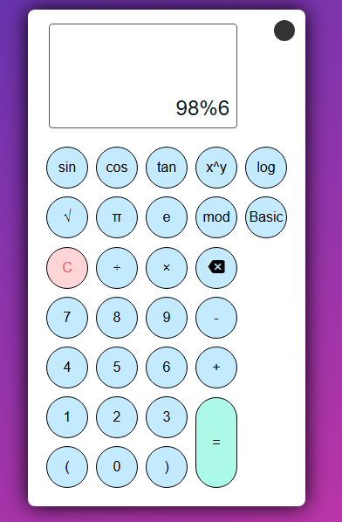
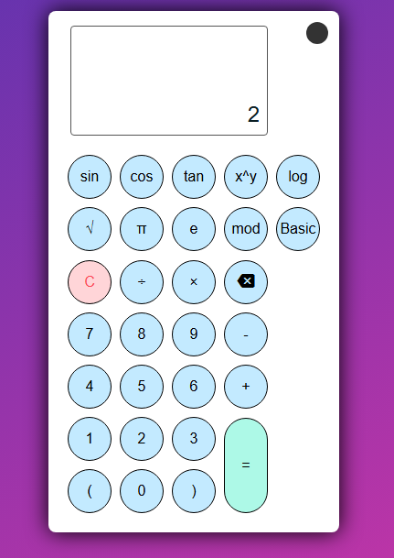
OUTPUT SCREENSHOT

Slide 16
CONCLUSION
In conclusion, the scientific calculator project successfully integrates both basic and advanced functionalities, providing users with a seamless experience when performing complex mathematical calculations. By offering dynamic toggling between basic and scientific modes, the calculator adjusts its layout and button labels accordingly, ensuring that the user interface remains intuitive and adaptable. The inclusion of advanced features such as trigonometric functions, logarithms, and other scientific operations further enhances its versatility.
This project has not only honed my skills in web development but also emphasized the importance of user-centered design in application functionality. While the current version meets the core requirements, future improvements could include additional features like unit conversions, graph plotting, and enhanced performance for large-scale calculations. Overall, the project stands as a robust, user-friendly tool for both casual and scientific users alike.

Slide 17
FUTURE ENHANCEMENTS
Unit Conversion: Add support for converting between different units (e.g., length, weight, temperature, volume) to expand the calculator’s functionality beyond mathematical operations.
Graph Plotting: Introduce a graphing feature to visualize functions, making the calculator a powerful tool for students and professionals in fields such as mathematics, physics, and engineering.
History and Memory Functions: Allow users to view a history of their calculations and store frequently used results or constants for quick access.
Voice Input: Integrate voice recognition functionality to enable users to dictate mathematical expressions, improving accessibility and ease of use.

Slide 18
REFERENCES
Don't Make Me Think - This book by Steve Krug introduces intuitive design principles, focusing on simplicity and user-friendliness, which are crucial for an easy-to-navigate calculator layout.
CSS: The Missing Manual - This guide explains CSS styling techniques, making it easier to create a responsive and visually appealing calculator interface across different screen sizes.
The Art of Scientific Computing: This resource details algorithms for mathematical functions like trigonometric calculations and logarithmic functions, essential for scientific calculators.
IEEE Standard for Floating-Point Arithmetic - IEEE 754 standards offer guidelines for floating-point calculations, ensuring accurate results in scientific calculators, especially for complex computations.
Web Accessibility Initiative (WAI) - This resource provides accessibility standards that help make the calculator interface usable for people with disabilities, ensuring inclusive design.

Slide 19
THANK YOU

